Slide 1
Introductory General Chemistry
Chemistry 3A
S. M. Halloran

Slide 2
Properties of Liquids and Solids as Phases
Surface Tension, Viscosity, Capillary Action
Crystalline Solids
Energy, Heat, Temperature
Heat Capacity
Describing Transitions of Phases: Melting, Freezing, Sublimation, Boiling, Evaporation, Condensation

Slide 3
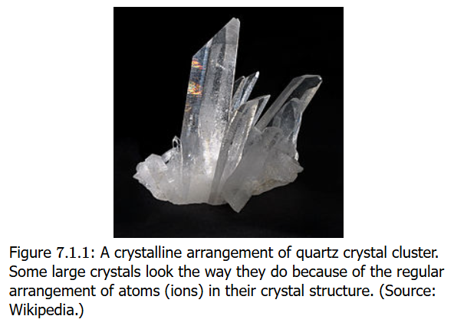
Liquid, Solids, Gases: Properties
Liquids and solids: condensed phases because particles in contact
Solids
particles in fixed positions
Definite shape and volume
Usually hard (crystals/rock), but sometimes soft (fat/wax)
Ionic solids quite brittle: 3-D array of positive & negative ions (crystal)
Large molecule solids (glass) cannot organize particles as crystals → amorphous solids

Slide 4
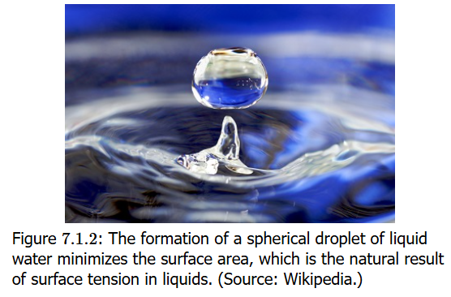
Liquid, Solids, Gases: Properties
Liquids
particles have enough (thermal) energy to overcome intermolecular interactions, but particles still move while contacting each other
Definite volume, but no definite shape

Slide 5
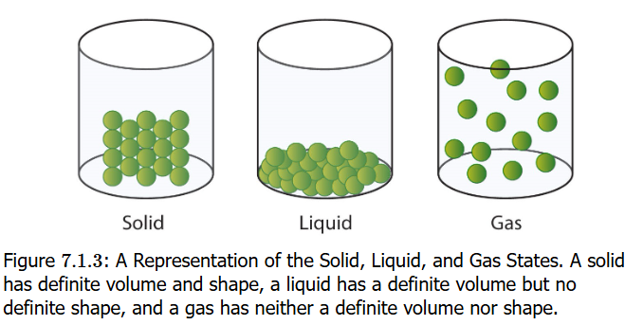
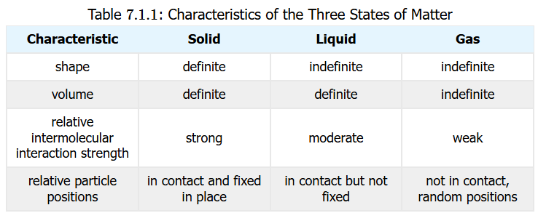
Liquid, Solids, Gases: Properties
Gases
Like liquids, particles have enough (thermal) energy to overcome intermolecular interactions & separate from each other, moving randomly in space
NO definite shape or volume
Volume increases by a 1000 times or more

Slide 6
Water
The liquid of life, the “universal solvent”
The density of ice is lower than for water
Water also absorbs and releases energy (as heat) without large changes in temperature, unlike solid metals like steel, made up of element iron (Fe)
Substance | Melting Point | Boiling Point
water | 0°C | 100°C
ammonia | –78°C | –33°C
Methane | –182°C | –162°C

Slide 7
Some Terms, Definitions
In the topics on surface tension, viscosity and capillary action to be discussed, certain terms should be understood
Cohesion describes the force or attraction of molecules of the same kind/identity to each other. This describes how H₂O (water) molecules will create a water droplet. Verb infinitive: to cohere
Adhesion describes the force or attraction of molecules of different kind/identity to each other, such as when H₂O (water) sticks to sides of glass. Verb infinitive: to adhere

Slide 8
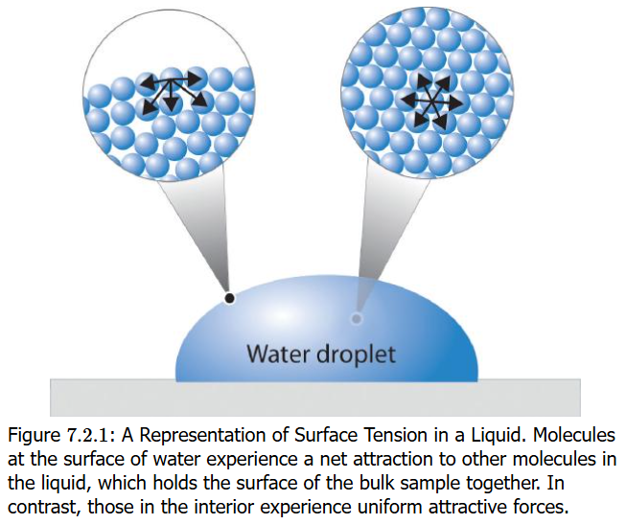
Surface Tension
Surface tension is the property of a liquid's surface to resist an external force by minimizing its surface area, caused by the cohesive (intermolecular) forces between liquid molecules that are imbalanced at the surface
Water has a high surface tension: it explains why water forms droplets form on a waxy surface (leaves, car bodies) rather than spread themselves thin
Minimizing surface area: explains why water forms spherical droplets because sphere is smallest possible surface area for any volume

Slide 9
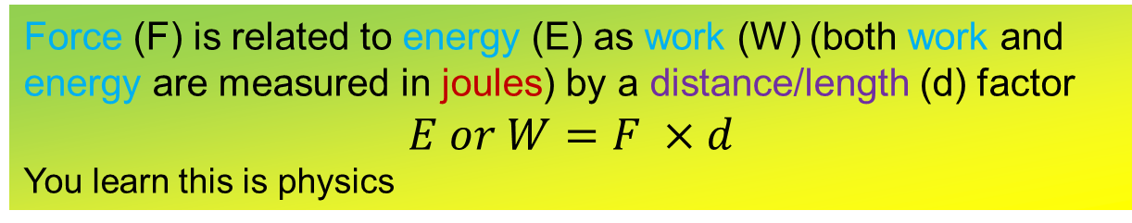
Surface Tension UNITS
Surface tension is a quantity with units of joules (J) per square meter (m²): J / m² OR dyne (dyn) per centimeter (cm): dyn/cm
The joule is measure of energy while the dyne and the newton [N] (1 N = 100,000 dyn) is a measure of force
The higher (stronger) the intermolecular forces, the higher the surface tension
Water has very high intermolecular force (because of hydrogen bonding [later] while organic molecules have lower intermolecular force/surface tension
Force (F) is related to energy (E) as work (W) (both work and energy are measured in joules) by a distance/length (d) factor
$$E or W=F ×d$$
You learn this is physics

Slide 10
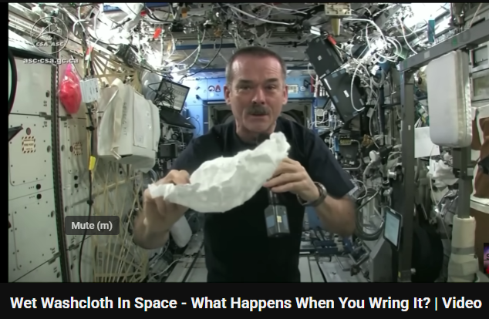
Surface Tension Fun
Surface tension at zero gravity: check it out
https://www.youtube.com/watch?v=lMtXfwk7PXg

Slide 11
Capillary Action
Capillary action is the movement of a liquid through or along a solid material, even against gravity, driven by the forces of cohesion (a liquid's attraction to itself), adhesion (a liquid's attraction to a solid surface), and surface tension. When the adhesive forces between the liquid and the solid are stronger than the cohesive forces within the liquid, the liquid will "climb" the solid, which is seen in examples like a paper towel absorbing a spill or water traveling up a plant's xylem.

Slide 12
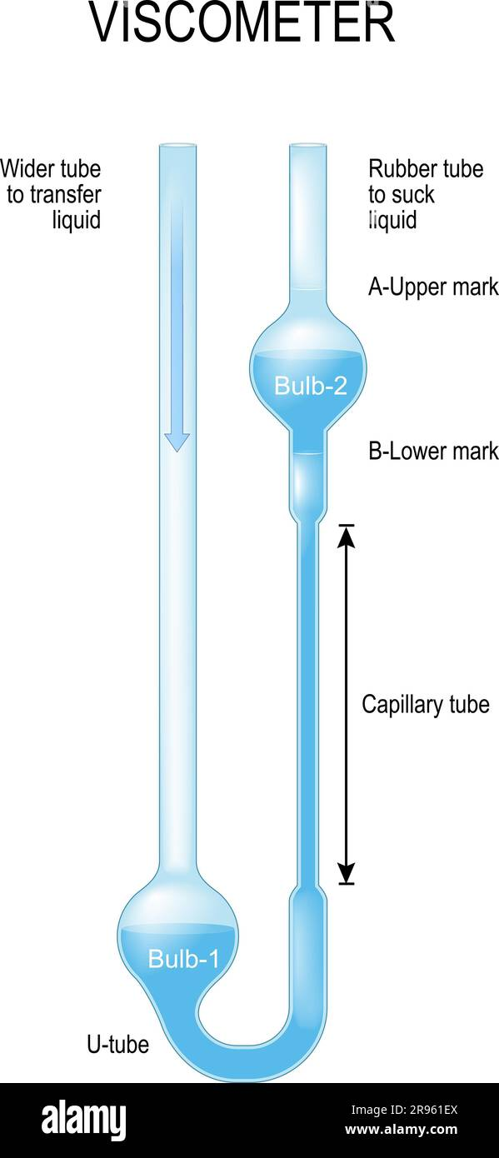
Viscosity
Viscosity (symbol Greek letter eta η) is the resistance of a fluid to flow, often described as its "thickness" or internal friction
A viscometer is a special glass device that measures time it takes for test liquid to flow through narrow vertical tubing
Units of viscosity: poise (1 poise = 1 mPa s)
If a liquid has strong intermolecular forces, the molecules will not move past each other but slowly. Adding an –OH group to ethanol (CH3CH2OH) to make ethylene glycol (HOCH2CH2OH)

Slide 13
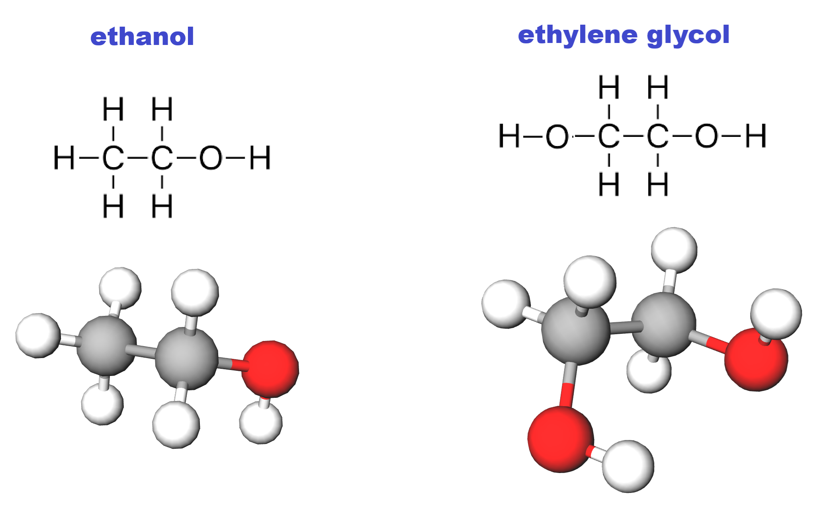
Viscosity
If a liquid has strong intermolecular forces, the molecules will not move past each other but slowly. Adding an –OH group to ethanol (CH₃CH₂OH) to make ethylene glycol (HOCH₂CH₂OH) increases viscosity by 15 times

Slide 14
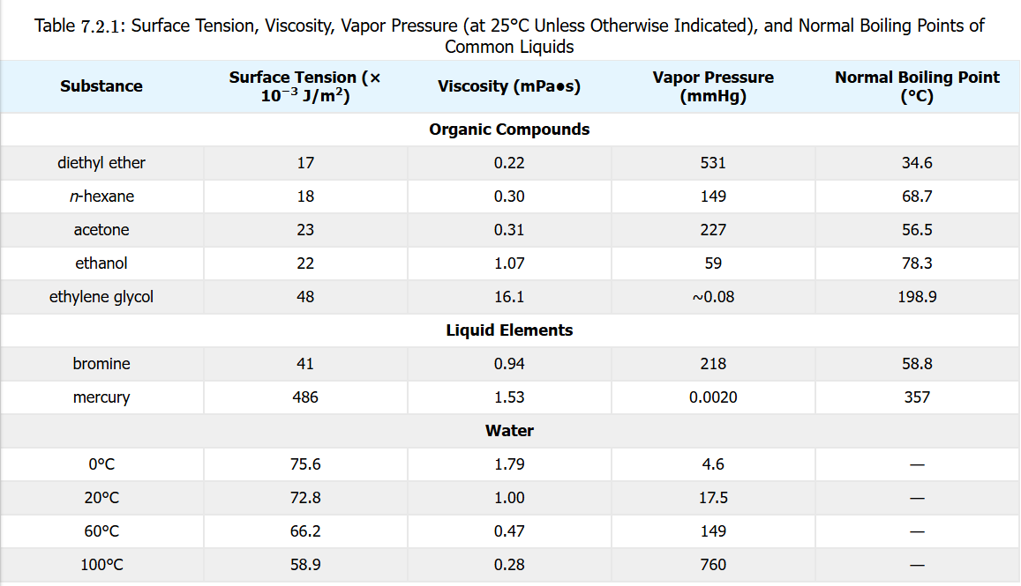
Liquid Properties in Review

Slide 15
Crystalline Solid Classes
Ionic
Metallic
Covalent Network
Molecular

Slide 16
LAW of Conservation of Energy
Exothermic
Endothermic

Slide 17
Energy: Heat & Work
Kinetic Energy
Potential Energy
Chemical Energy
Measuring Energy

Slide 18
Calculations of Heat & Energy
Kinetic Energy
Potential Energy
Chemical Energy
Measuring Energy

Slide 19
Heat Capacity

Slide 20
Specific Heat

Slide 21
Phase Transitions
Melting
Freezing
Boiling/Vaporization
Condensation
Evaporation
Sublimation

Slide 22
Melting/Freezing/Sublimation
Melting Point
Sublimation/Deposition

Slide 23
Boiling/Evaporation/Condensation
Boiling Point
Sublimation/Deposition

Slide 24
Phase Change Energy Calculations

Slide 25
Heating Curves/Cooling Curves

